Slide 1
SharePoint 2007 Implementing WebParts
© 2007 Alexander Pajer

Slide 2
Agenda
Webpart Basics
Developing Basic WebParts
Connecting WebParts
Developing Custom Editor Parts
Packaging and Deploying WebParts

Slide 3
Webpart Basics

Slide 4
What is a WebPart?
A WebPart is a ASP.NET Custom Control that can be placed in a WebPartZone in a Site
WebParts can be used to display any content – they can also be used to implement custom functionality
WebParts can make use of AJAX Extentions and Silverlight
In case the Rendering of the WebPart produces an error it can be removed by adding „?contents=1“ to the URL

Slide 5
Components of the WebPart Framework
SPWebPartManager Located on the MasterPage and responsible for serializing Web-Part-related data, as well as persisting the state of a WebPart
SPWebPartZone Defined in Microsoft.SharePoint.WebPartPages is a Container Control located on the MasterPage and serves as a host for WebParts

Slide 6
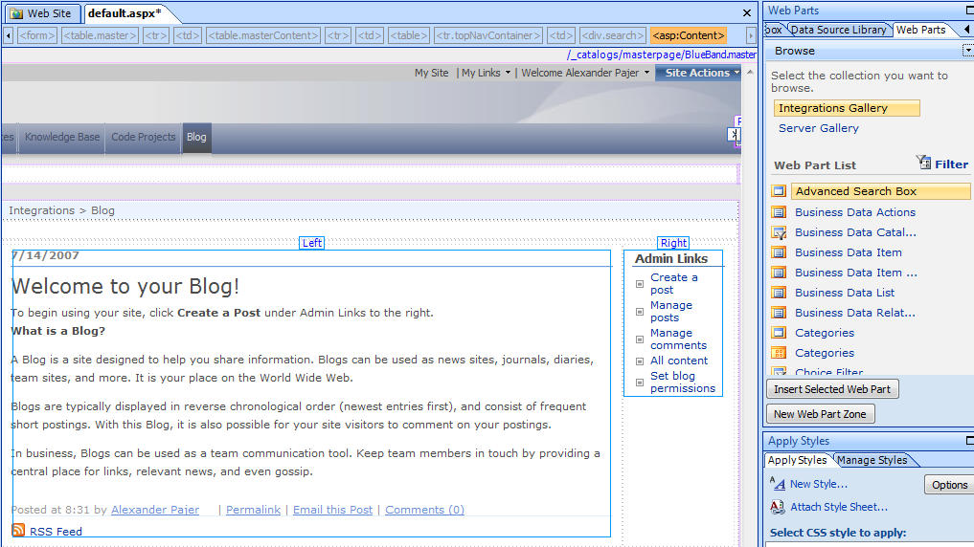
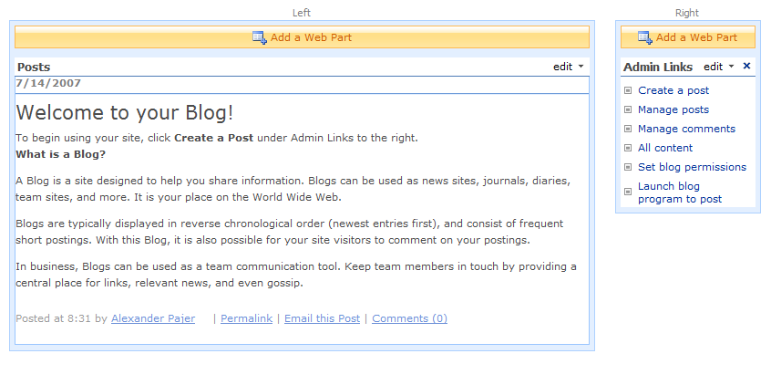
Layout of a WebPartPage
SPWebPartManager
WebPart Zone
WebPart Zone
EditorZone
WebPart
WebPart
WebPart
WebPart

Slide 7
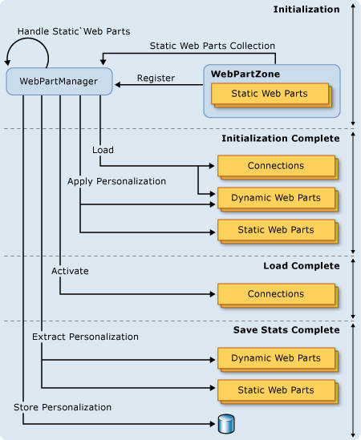
Web Part Life Cycle
Instantiate : The constructor
Initialize : OnInit method and Init event
Load : OnLoad method and Load Event
(*) Raise Changed Events : IPostBackDataHandler, RaisePostDataChangedEvent method
(*) Raise Postback Events : IPostBackEventHandler, RaisePostDataEvent method
PreRender : OnRender method, and PreRender event
Render: Render method
Unload: OnUnload method and Unload event
Dispose: Dispose method

Slide 8
Page Security Validation
When updating data using ASPX SharePoint has a built in security feature called Page Security Validation
To turn off security validation use the following patterns in your code
SPSite.WebApplication.FormDigestSettings.Enabled = false
SPSite.AllowUnsafeUpdates = true;

Slide 9
Demo
Common SharePoint WebParts

Slide 10
Developing Basic Webparts

Slide 11
WebPart Inheritance
Control
System.Web.dll
WebControl
Panel
WebControl
Part
WebPart
WebPart
Microsoft.SharePoint.dll 2.0
Microsoft.SharePoint.dll 3.0

Slide 12
A Basic Webpart
[Guid("4effc947-19e5-4ba6-8ad5-818f41634ddd")]
public class SimpleWebpart : System.Web.UI.WebControls.WebParts.WebPart
{
protected Label lblMessage;
protected override void CreateChildControls()
{
SPWeb web = SPContext.Current.Web;
string msg = string.Format("Hello {0}, welcome to web {1}", web.CurrentUser.LoginName, web.Title);
lblMessage = new Label();
lblMessage.Text = msg;
Controls.Add(lblMessage);
}
}

Slide 13
Render Method
If you need to you can override the Render-method
protected override void Render(HtmlTextWriter writer)
{
writer.Write("<div id=\"mainbody\" style=\"width:500px;overflow:auto;\">");
foreach (Control c in Controls)
{
c.RenderControl(writer);
}
writer.Write("</div>");
}

Slide 14
Packing and Deploying WebParts

Slide 15
Deploying WebParts
WebParts can be deployed to
Bin-Directory
Global Assembly Cache
Metadata for V3 Webparts is automatically generated using Reflection
On your Development Machinge use VSeWss to automatically create a Feature

Slide 16
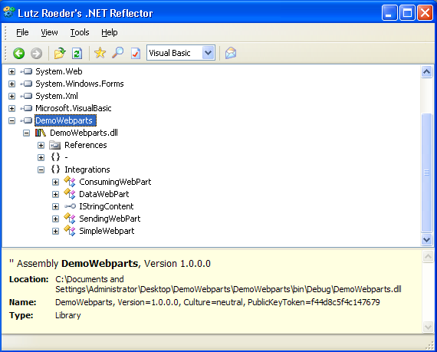
Code Access Security
The Assembly in which the WebPart is implemented has to be marked as safe in web.config
<SafeControl Assembly="DemoWebparts, Version=1.0.0.0, Culture=neutral, PublicKeyToken=f44d8c5f4c147679"
Namespace="Integrations"
TypeName="*"
Safe="True" />

Slide 17
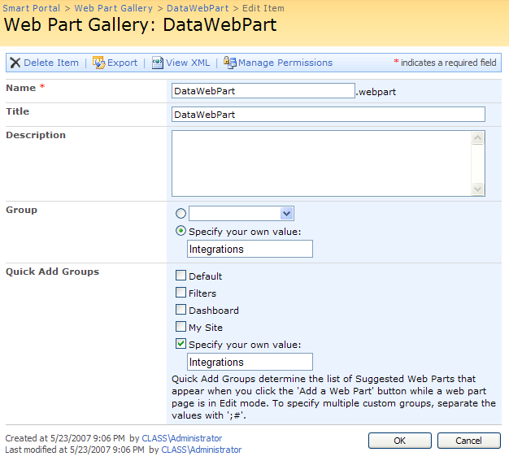
WebPart Metadata
WebPart Metadata can be customized using the UI

Slide 18
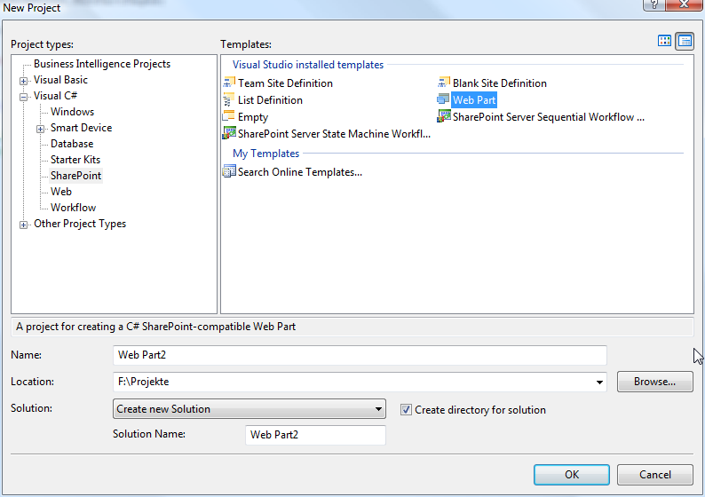
Using VSeWSS WebPart Template

Slide 19
WebPart Properties
Allows customization of a WebPart
// initializes the connection string
private string constr = „ ... ";
[Personalizable(PersonalizationScope.Shared), WebBrowsable(true),
WebDisplayName(„DB Connection String"), WebDescription(„ ... ")]
public string DBConnString
{
get { return constr; }
set { constr = value; }
}

Slide 20
Adding Controls to WebParts
Create Controls using CreateChildControls()
private Button btn;
protected override void CreateChildControls()
{ btn = new Button();
btn.ID = btn1;
btn.Text = "Click me";
btn.Click += new EventHandler(ButtonClicked);
Controls.Add(btn); }
void ButtonClicked(object sender, EventArgs e)
{ btn.Text = "You clicked me"; }

Slide 21
WebPart Rendering
Override RenderContentents to render the contents of the Webpart
protected override void RenderContents(HtmlTextWriter writer)
{
foreach (Control c in Controls)
{
c.RenderControl(writer);
}
}

Slide 22
Persisting State
WebParts inherit the ViewState from System.Web.UI.Control
State information is automatically serialized and loaded
Default behaviour can be changed by overriding LoadViewState()

Slide 23
Demo
Creating a Simple Webpart
Creating a WebPart that displays data from a custom DB using a GridView

Slide 24
Connecting Webparts

Slide 25
Connected WebParts
Connecting WebParts allows a value from one WebPart to be used as an input, a sort, or a filter for the display of another WebPart
To implement connected WebParts create:
A connection Interface defining the data to be shared
A WebPart providing data using the Interface
A WebPart consuming data using the Interface

Slide 26
Connection Interfaces
SharePoint provides standard Connection Interfaces that allow for data exchange
Interface | Purpose
IWebPartField | Allows a WebPart to provide or consume a cell of data
IWebPartRow | Allows a WebPart to provide or consume a row of data
IWebPartTable | Allows a WebPart to provide or consume a recordset of data
IWebPartParameters | Allows a WebPart to provide or consume multiple cells of data that cen be mapped to the data cells in another WebPart

Slide 27
Custom Connection Interfaces
Custom Connection Interfaces can be used to share information between WebParts
// define the interfact used for data exchange
public interface IStringContent
{
string StringValue { get;}
}

Slide 28
Implementing a Provider WebPart
Requirements to provide Data
Implement the custom connection interface
Expose a Property that returns a reference to the connectable interface
The Property must be decorated with the ConnectionProvider attribute

Slide 29
Implementing a Provider WebPart
// implement the sending webpart
[Guid("1427bd12-bd1f-4a7c-8c93-9071edff9b02")]
public class SendingWebPart : System.Web.UI.WebControls.WebParts.WebPart, IStringContent
{
// an internal field to store the values
protected string stringValue = string.Empty;
[ConnectionProvider("String Provider")]
public IStringContent SharedData()
{ return this; }
public string StringValue
{ get { return stringValue; } }
}

Slide 30
Implementing a Consumer WebPart
Requirements to consume Data
Contain a methode for receiving the connection interface
The methode must be decorated with the ConnectionConsumer attribute

Slide 31
Implementing a Consumer WebPart
// implement the consuming webpart
[Guid("1427bd12-bd1f-4a7c-8c93-9071edff9b03")]
public class ConsumingWebPart : System.Web.UI.WebControls.WebParts.WebPart
{
private IStringContent data = null;
[ConnectionConsumer("String Consumer")]
public void GetConnectionInterface(IStringContent ExchangedData)
{
data = ExchangedData;
}
}

Slide 32
Demo
Implementing Connected WebParts

Slide 33
Developing Custom Editor Parts

Slide 34
Custom Editor Part
Custom Editor Parts override the default Editor Part that is show when configuring a WebPart on WebPart page
Custom Editor Parts have to be implemented when the WebPart exposes properties other than SharePoints base types or special user experience is required (e. g. browsing for a list)

Slide 35
Implementing Custom Editor Parts
To use the Custom Editor Part override CreateEditorParts() in the WebPart where you want to use it
Inherit from EditorPart
OverrideCreateChildControls()
Override RenderContents()
Override SyncChanges()

Slide 36
The Web Part To Be Configured
[Guid("c43904f3-08b0-4f8f-bd55-3f6b4462005a")]
public class SearchWP : WebPart
{
public SearchWP()
{
ListName = "Customers";
}
public string ListName { get; set; }
protected Table tbl;
protected DropDownList ddTitleSelection;
protected GridView gvResult;
protected Label lblMessage;

Slide 37
Create Edtor Parts
Overrid CreateEditorParts to use your custom Editor Part
public override EditorPartCollection CreateEditorParts()
{
ArrayList partsArray = new ArrayList();
CustomEditorPart ce = new CustomEditorPart();
ce.ID = ID + "_editorPart1";
ce.Title = "List";
partsArray.Add(ce);
EditorPartCollection parts = new EditorPartCollection(partsArray);
return parts;
}

Slide 38
Passing Values
SyncChanges() passes Values from the EditorPart to the WebPart
ApplyChanges() assigns the current Value of the public property of the WebPart to the EditorPart
public override void SyncChanges()
{
ddList.Text = ((SearchWP) WebPartToEdit).ListName;
}

Slide 39
ApplyChanges
public override bool ApplyChanges()
{try
{if (ddList.SelectedValue != string.Empty)
{
((SearchWP) WebPartToEdit).ListName = ddList.SelectedValue;
((SearchWP) WebPartToEdit).BindListDD();
lblMsg.Text = string.Empty;
}
else
((SearchWP) WebPartToEdit).ListName = "Please select a list";
}
catch (Exception ex)
{lblMsg.Text += ex.Message;}
return true;
}

Slide 40
Demo
Implementing a Custom Editor Part

Slide 41
THANK YOU!!
ALEXANDER.PAJER@INTEGRATIONS.AT

